Slide 1
Compiler Design

Slide 2

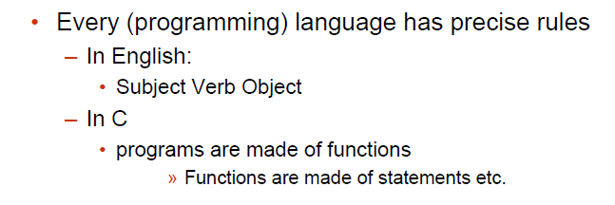

Slide 3
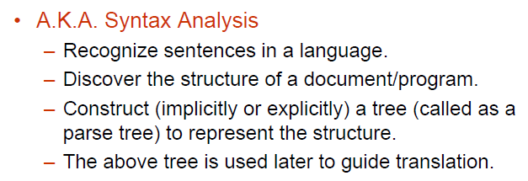
Parsing

Slide 4
Parsing During Compilation
regular expressions
errors
lexical analyzer
token
rest of front end
intermediate representation
source program
parser
parse tree
get next token
symbol table
Collecting token information
Perform type checking
Intermediate code generation
uses a grammar to check structure of tokens
produces a parse tree
syntactic errors and recovery
recognize correct syntax
report errors

Slide 5
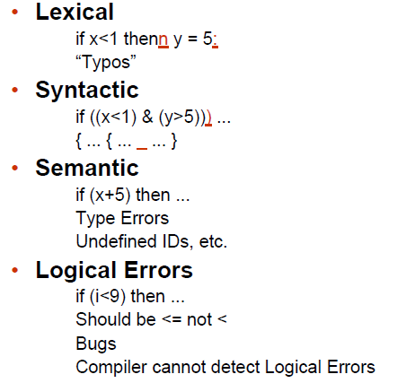
Errors in Programs

Slide 6
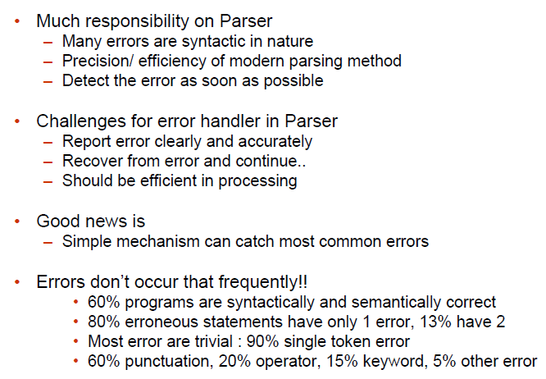
Error Detection

Slide 7
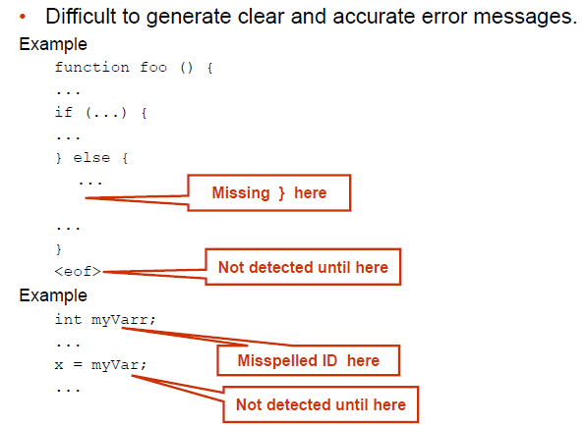
Adequate Error Reporting is Not a Trivial Task

Slide 8
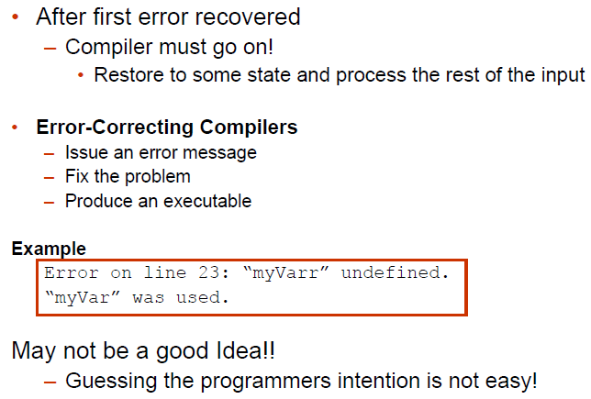
Error Recovery

Slide 9
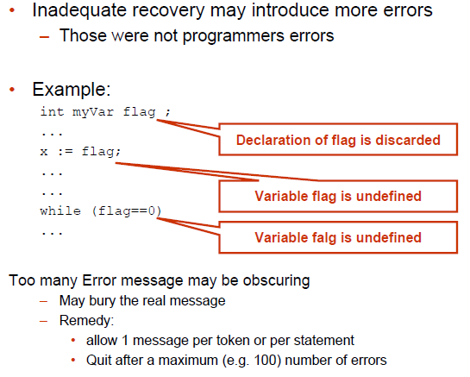
Error Recovery May Trigger More Errors!

Slide 10
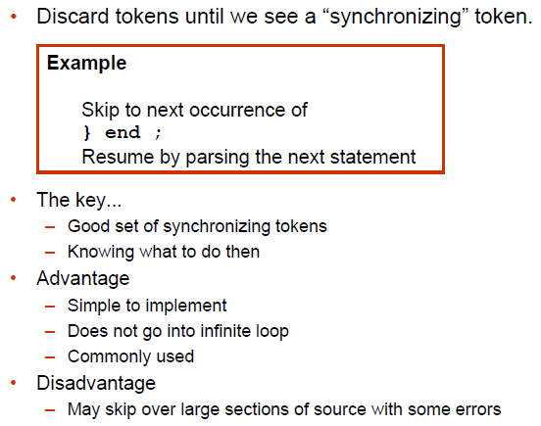
Error Recovery Approaches: Panic Mode

Slide 11
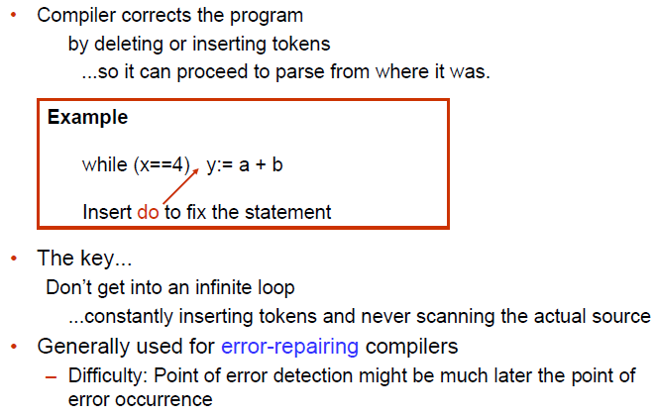
Error Recovery Approaches: Phrase-Level Recovery

Slide 12
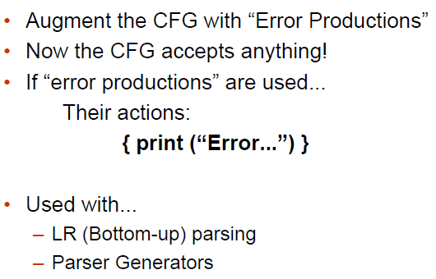
Error Recovery Approaches: Error Productions

Slide 13
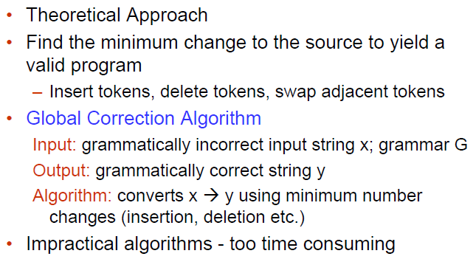
Error Recovery Approaches: Global Correction

Slide 14
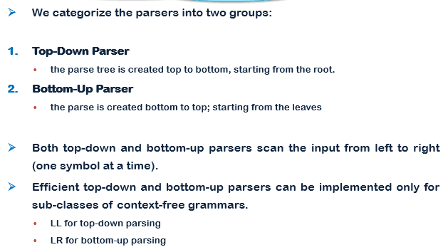
Parsers

Slide 15
Context Free Grammars (CFG)
A context-free grammar has four components: G = ( V, Σ, P, S )
A set of non-terminals (V). Non-terminals are syntactic variables that denote sets of strings. The non-terminals define sets of strings that help define the language generated by the grammar.
A set of tokens, known as terminal symbols (Σ). Terminals are the basic symbols from which strings are formed.
A set of productions (P). The productions of a grammar specify the manner in which the terminals and non-terminals can be combined to form strings. Each production consists of a non-terminal called the left side of the production, an arrow, and a sequence of tokens and/or on- terminals, called the right side of the production.
One of the non-terminals is designated as the start symbol (S); from where the production begins.

Slide 16
Example of CFG:
G = ( V, Σ, P, S )Where:
V = { Q, Z, N }
Σ = { 0, 1 }
P = { Q → Z | Q → N | Q → ℇ | Z → 0Q0 |
N → 1Q1 }
S = { Q }
This grammar describes palindrome language, such as: 1001, 11100111, 00100, 1010101, 11111, etc.

Slide 17
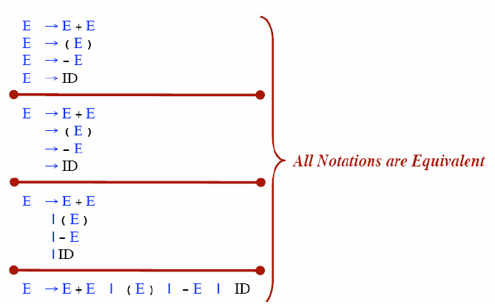
Rule Alternative Notations

Slide 18
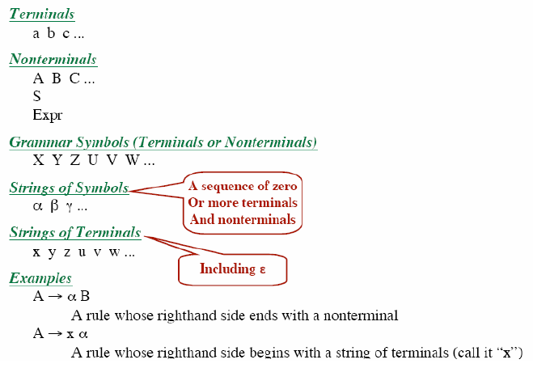
Notational Conventions

Slide 19
Derivations
A derivation is basically a sequence of production rules, in order to get the input string. During parsing, we take two decisions for some sentential form of input:
Deciding the non-terminal which is to be replaced.
Deciding the production rule, by which, the non-terminal will be replaced.
To decide which non-terminal to be replaced with production rule, we can have two options.

Slide 20
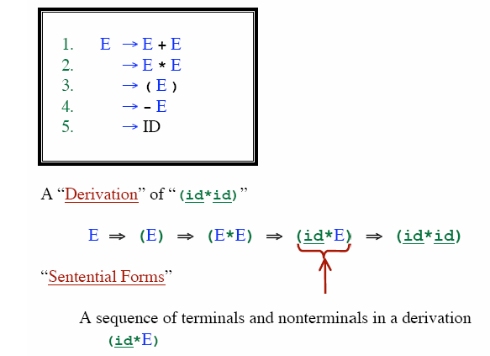
Derivations

Slide 21
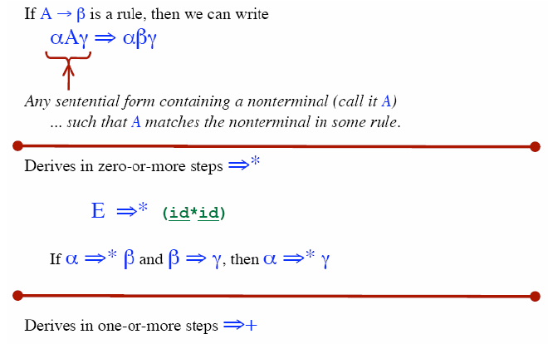
Derivations

Slide 22
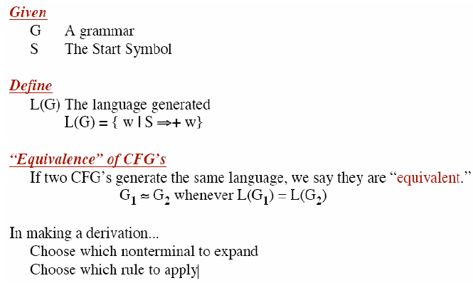
CFG Terminology

Slide 23
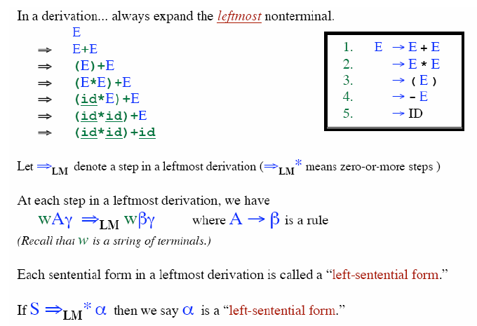
Leftmost Derivation

Slide 24
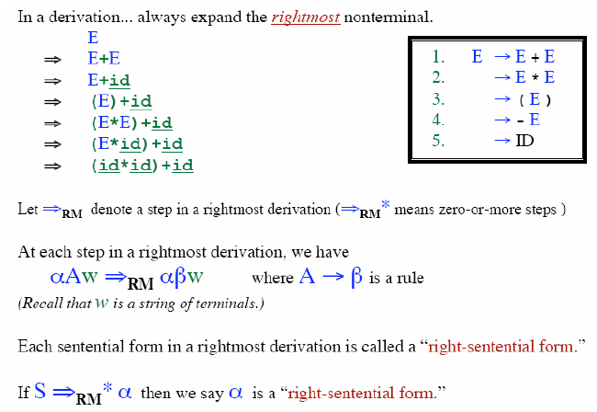
Rightmost Derivation

Slide 25
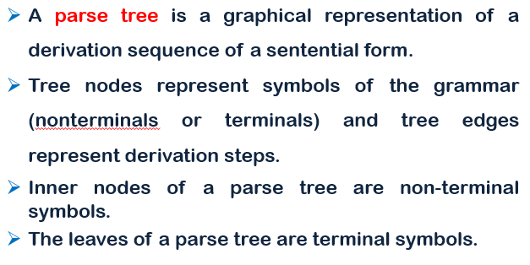
Parse Tree

Slide 26
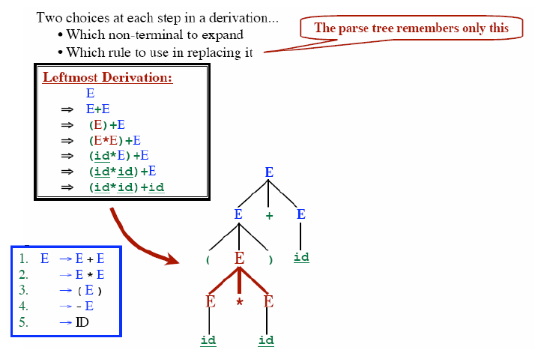
Parse Tree

Slide 27
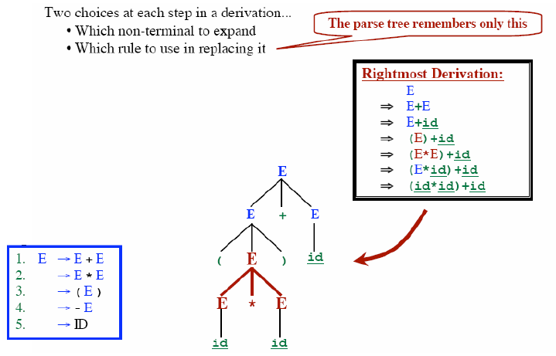
Parse Tree

Slide 28
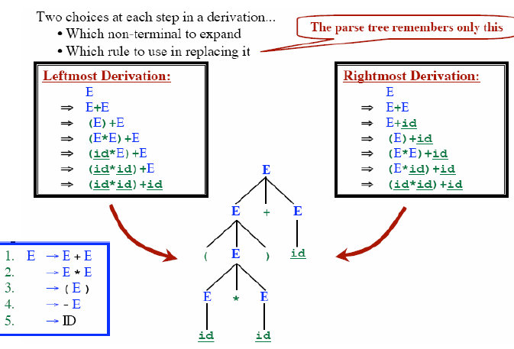
Parse Tree
Notes:
, the phrase “x = +y", which is recognized as four tokens, representing “x", “=“ and “+" and “y", has the structure =(x,+(y)), i.e., an assignment expression, that operates on “x" and the expression “+(y)".

Slide 29
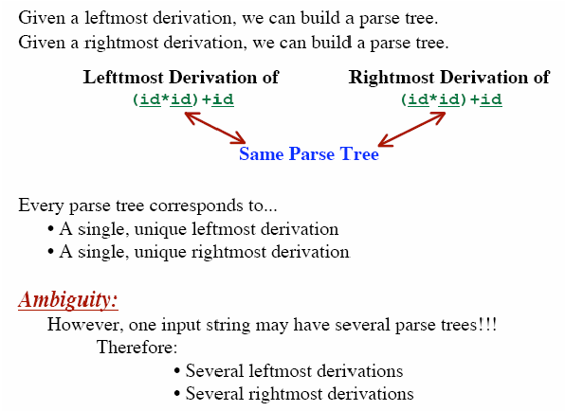
Parse Tree

Slide 30

Ambiguous Grammar

Slide 31
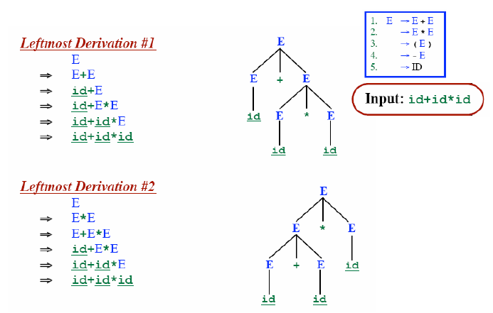
Ambiguous Grammar

Slide 32
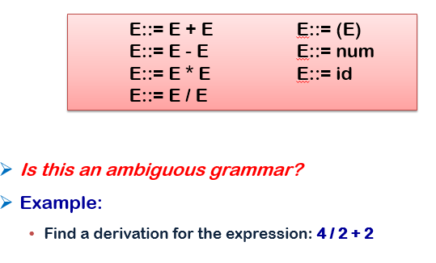
Ambiguous Grammar

Slide 33
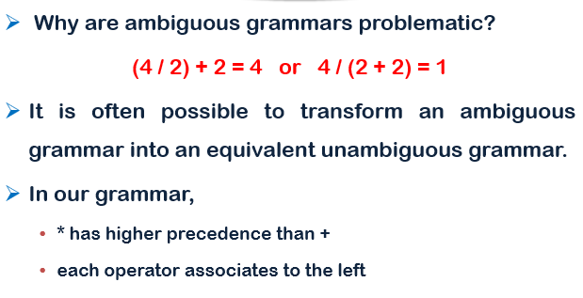
Ambiguous Grammar

Slide 34
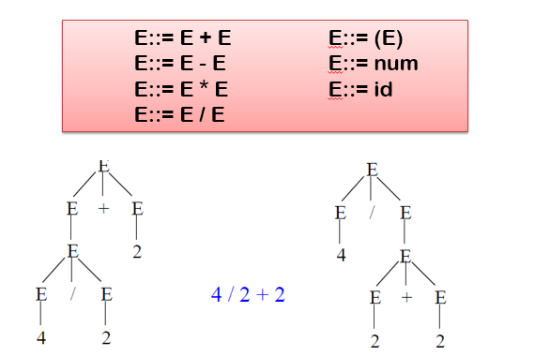
Ambiguous Grammar

Slide 35
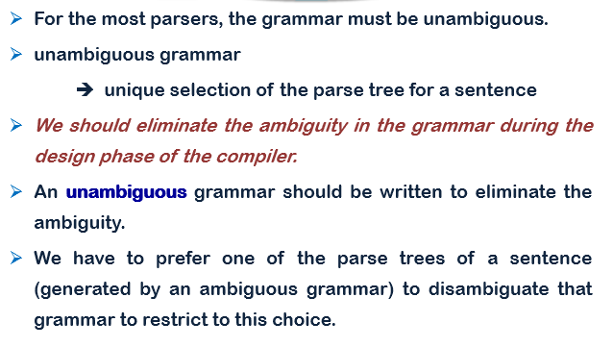
Ambiguous Grammar

Slide 36
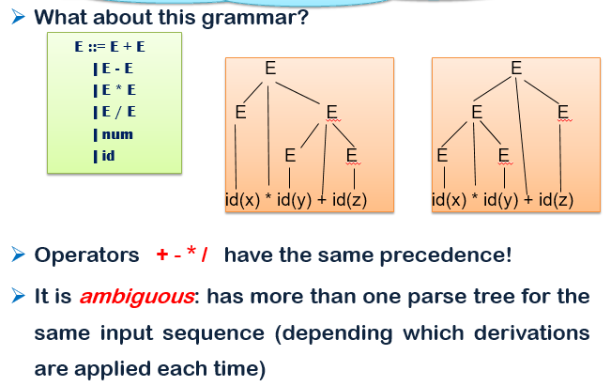
Ambiguous Grammar

Slide 37
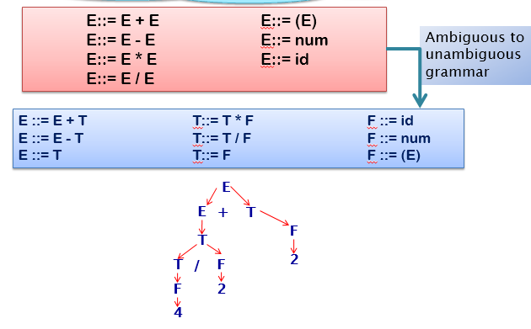
Unambiguous Grammar

Slide 38
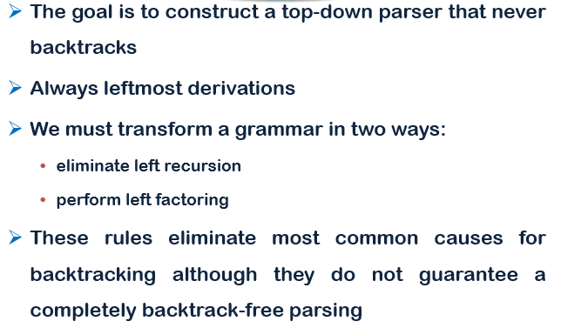
Predictive Parsing

Slide 39

Left Recursion: Infinite Looping problem
A grammar is left-recursive if it has a non-terminal A, such that there is a derivation :
A ⇒ Aα, for some α.
+
Top-Down parsing can’t reconcile this type of grammar, since it could consistently make choice which wouldn’t allow termination.
A ⇒ Aα ⇒ Aαα ⇒ Aααα … etc. A→ Aα | β
So we have to convert our left-recursive grammar into an equivalent grammar which is not left-recursive.

Slide 40
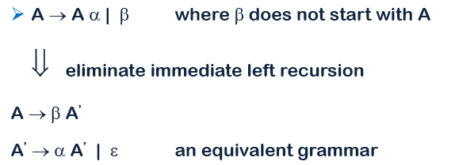

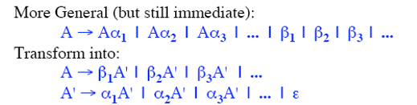
Immediate Left Recursion

Slide 41
Immediate Left Recursion Elimination: example
Our Example :
E → E + T | T
T → T * F | F
F → ( E ) | id
E → TE’ E’ → + TE’ | ∈
T → FT’ T’ → * FT’ | ∈
F → ( E ) | id

Slide 42
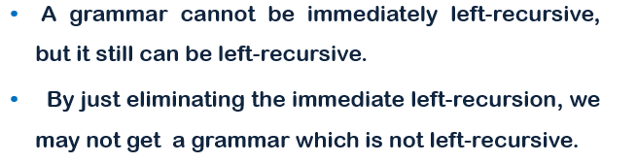
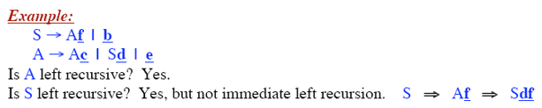
Left Recursion in More Than One Step

Slide 43
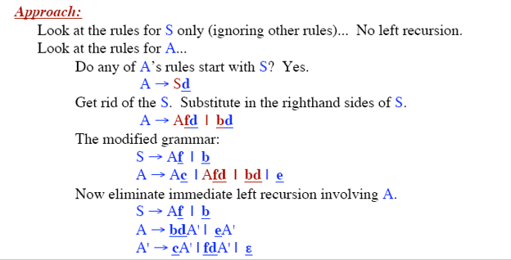
Left Recursion in More Than One Step: Elimination

Slide 44
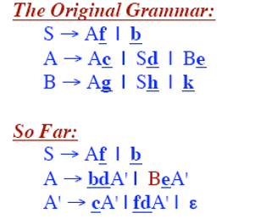
Left Recursion in More Than One Step: Elimination

Slide 45
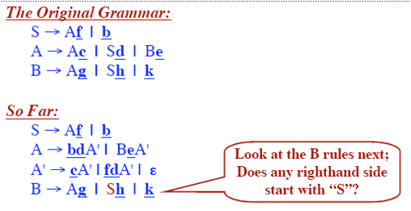
Left Recursion in More Than One Step: Elimination

Slide 46
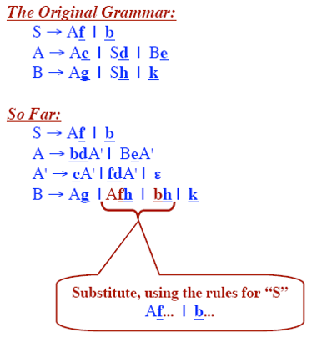
Left Recursion in More Than One Step: Elimination

Slide 47
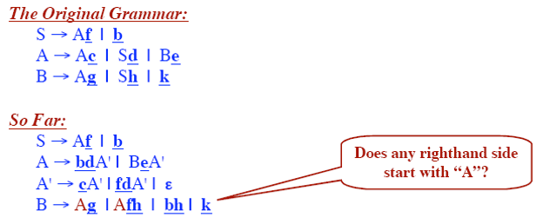
Left Recursion in More Than One Step: Elimination

Slide 48
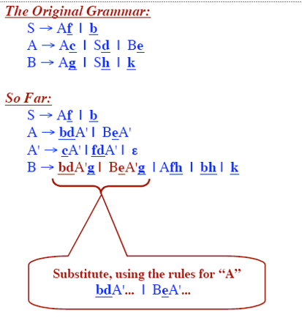
Left Recursion in More Than One Step: Elimination

Slide 49
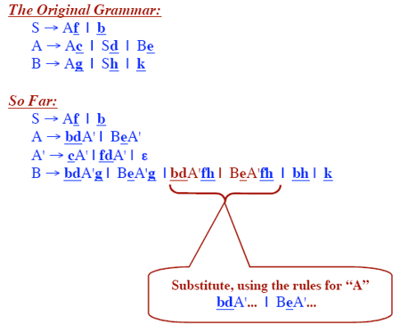
Left Recursion in More Than One Step: Elimination

Slide 50
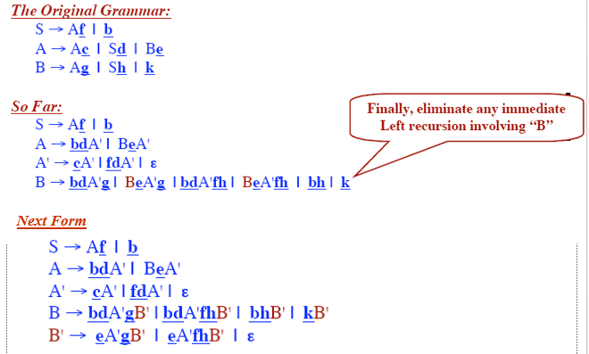
Left Recursion in More Than One Step: Elimination

Slide 51
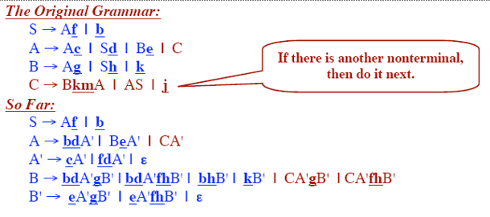
Left Recursion in More Than One Step: Elimination

Slide 52
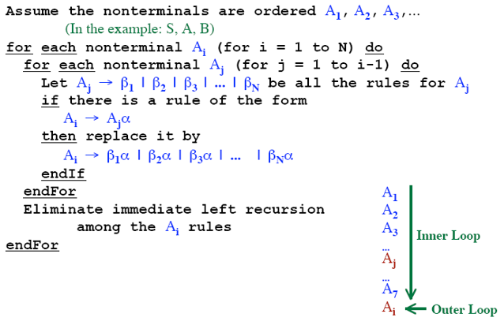
Algorithm for Eliminating Left Recursion

Slide 53
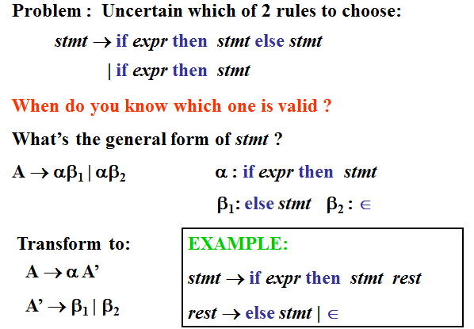
Left Factoring: Common Prefix Problem

Slide 54
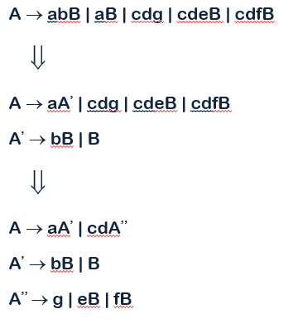
Left Factoring : Example

Slide 55
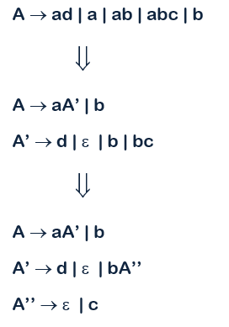
Left Factoring : Example

Slide 56
The End

